Slide 1
QFTB – Onboarding and Training
April 7, 2020

Slide 2
Co-Chairs Justin Grishkin Becca Puleo Members David Amundson Kevin Farthing Sharon Ginn Melanie Lester Jaime Perpinan

Slide 3
Methodology
Shared personal experiences with onboarding and training
Attended Central HR’s “Onboarding Best Practices” training
Compared existing Central HR, FASS HR and CPFM resources
Evaluated responsible parties for onboarding and trainings
Finalized short, mid and long-term recommendations

Slide 4
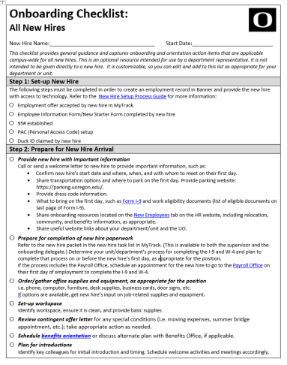
Onboarding Recommendations
Short-term
Immediate to
6 months
Standardize onboarding checklists
Mid-term
6 months to
18 months
Begin position specific customization to checklists
Long-term
Longer than
18 months
Finalize position specific customization of checklists
Designate orientation partners
Create implementation plans
Provide Onboarding Resources training for supervisors
Establish CPFM Onboarding and Training Subcommittee
Integrate results of training content development

Slide 5
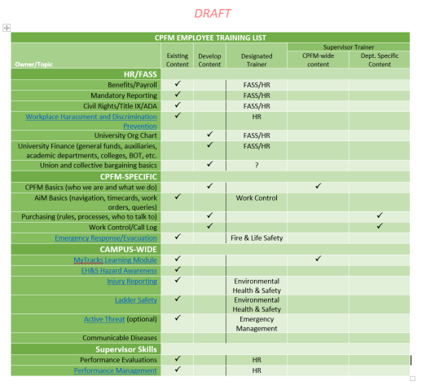
Training Recommendations
Short-term
Immediate to
6 months
Create generic CPFM Training List
Mid-term
6 months to
18 months
Implement a 90-day check-in for New Hires
Long-term
Longer than
18 months
Supervisors audit short and medium-term training goals
Endorsement by Leadership of training development
Develop list of required trainings for all CPFM employees
Create a 0.5 FTE CPFM Training Manager or Coordinator position to help implement all recommendations
Identify position specific training and professional development goals
Require review of professional development goals in annual evaluations

Slide 6
Outcomes
Consistent onboarding experience for all CPFM New Hires
Trust established through onboarding checklists and orientation partners
Engagement of supervisors in employee onboarding and training
Professional Development for all staff – supporting opportunities for career growth by promoting job satisfaction which will increase job retention

Slide 7
Questions?

