Slide 1
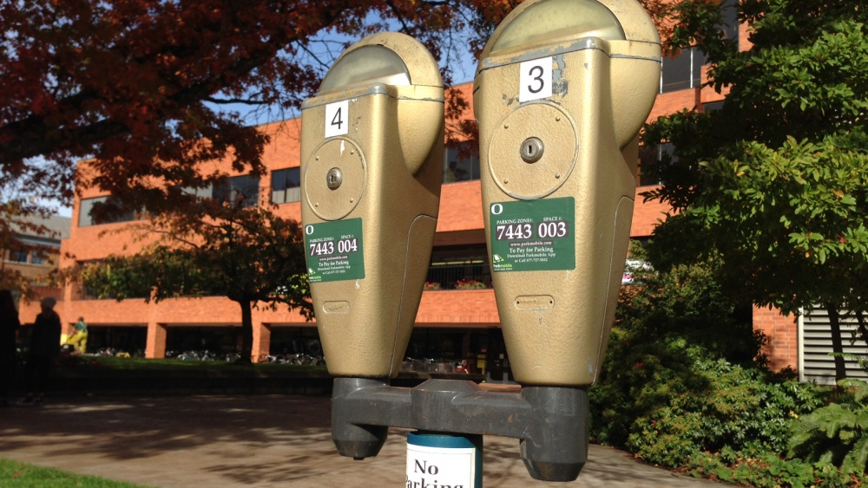
Quest for the Best – Parking Work Group
March 10, 2020
Ashleigh Sizemore – CPFM
Boz Van Houten – Utilities &Energy
Aaron Olsen – Campus Planning
Rick Schwab – Utilities & Energy
Jered Lewis – Utilities & Energy
Judy Peters – Facilities Services

Slide 2
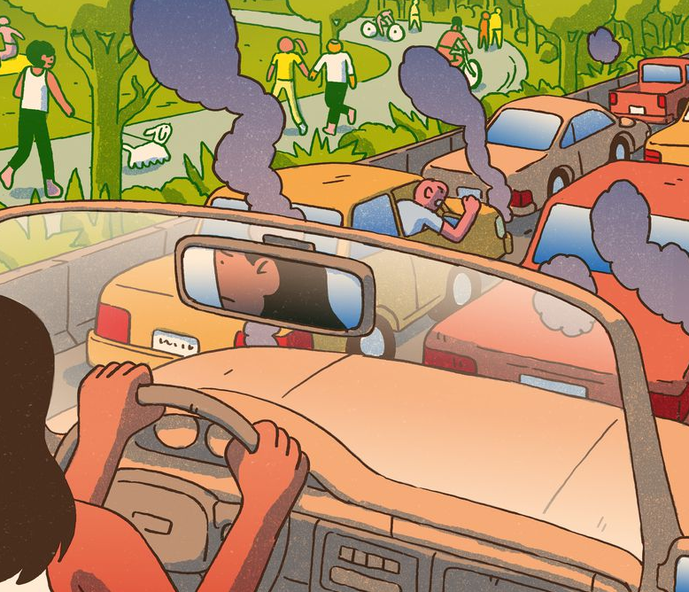
Issue: CPFM staff not aware of transportation options
Short Term Solutions
Supervisors to make staff aware of the UO Transportation Guide; provide hard copy for those interested
Arrange time for Transportation Services to meet with departments or groups to discuss transportation options
Provide updates in the CPFM newsletter about future parking projects, for example information about when the parking garage will be complete and how many spaces
Include transportation information on CPFM website
Medium Term Solutions
Ensure new hires are made aware of Transportation Services and options during onboarding
Engage with Transportation Services on a regular basis to learn of new transportation options or new information. Include regular updates to keep CPFM informed of Transportation Services’ priorities and information. Post updates to CPFM newsletter.

Slide 3
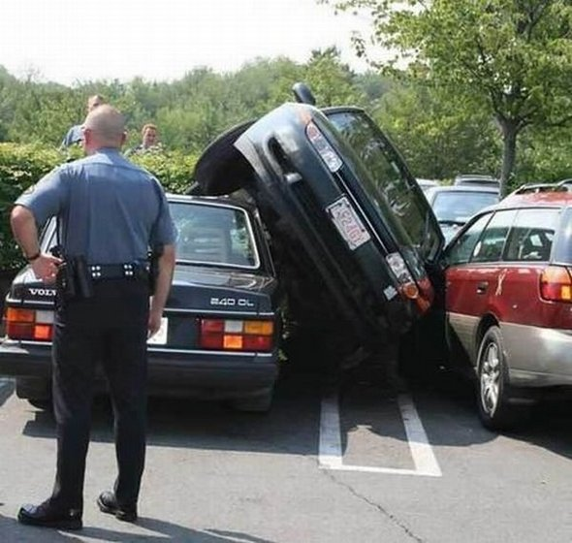
Issue: Need more parking on campus. Parking not available after 8:30 most days
Short Term Solutions
Encourage alternate modes of transportation: bike, bus, walk, etc.
Encourage use of park and ride (or park and walk) options, for example Autzen Stadium parking lot
Medium Term Solutions
Evaluate whether additional parking could be constructed in the Back 40 for CPFM employees
Long Term Solutions
Support construction of another parking garage, in addition to current project
Change 901 Franklin lot to be university managed instead of leased
Consider park and ride options with a CPFM shuttle
Encourage Transportation Services to establish more park and ride lots along EmX or bus routes, for example UO motor pool, West Eugene, Springfield, South Eugene, etc.

Slide 4
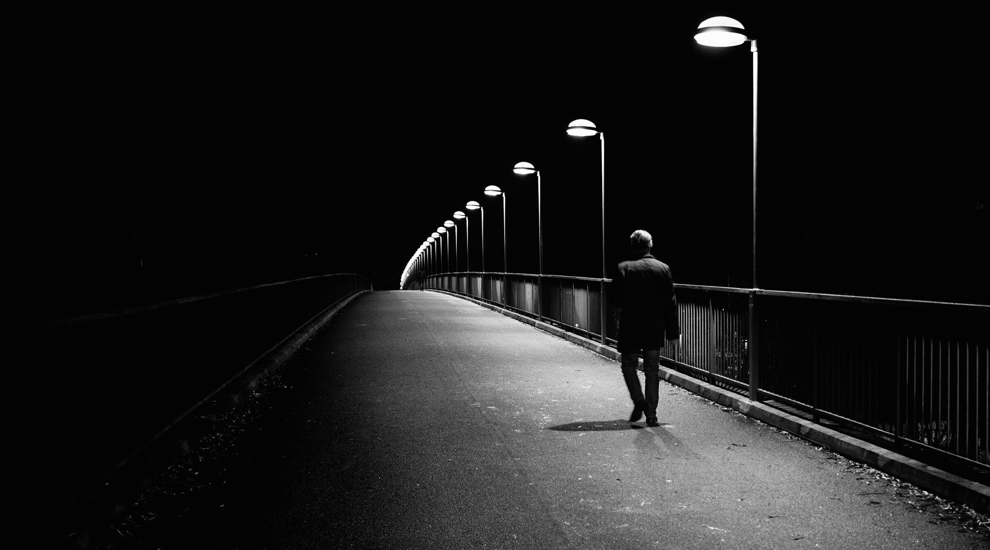
Issue: Safety concerns walking to/from Autzen parking lot
Short Term Solutions
Coordinate with UOPD to have security staff establish a planned time to walk to/from Autzen at common commute times
Encourage CPFM employees to arrange groups to walk together. Explore how MS Teams could help facilitate groups.
Medium Term Solutions
Consider CPFM having our own van/shuttle pick up employees at Autzen park to promote use (versus riding the bus)
Hire a bike valet or pedicab to promote parking at Autzen
Encourage PeaceHealth Rides to locate bikes at Autzen (future scooters?)
Long Term Solutions
CPFM to support discussions with City to allow potential golf cart shuttle on path system
Install emergency phones along path

Slide 5
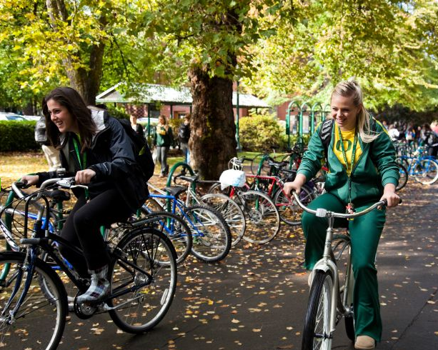
Issue: Encourage use of alternate means of transportation other than single occupancy cars
Medium Term Solutions
Consider incentives to bike, walk, bus, or car pool. Could be a quarterly raffle for a duck store gift card or something similar
Add carpool spaces “behind the fence”
Request converting a couple spaces to “carpool” in Lot 2
Long Term Solutions
(Consider partnerships with Bike Program and Transportation Services)
Support bike fix-it days where CPFM could partner with local mechanics to tune up bikes for employees who ride to work. Support having a permanent bike mechanic and secure storage area (broader campus approach)
Encourage groups of people travelling from similar locations to car pool

Slide 6
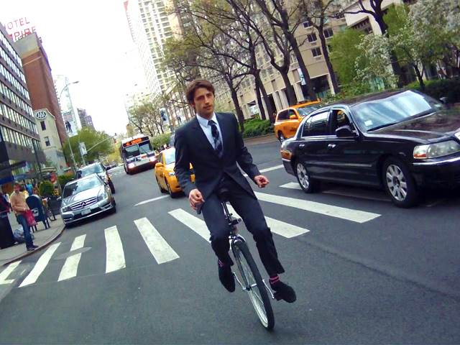
Issue: No information on how CPFM staff get to work
Short Term Solutions
Send a survey to all CPFM employees to learn how people get to work to establish a baseline to evaluate change and learn the types of transportation solutions that are of interest

Slide 7
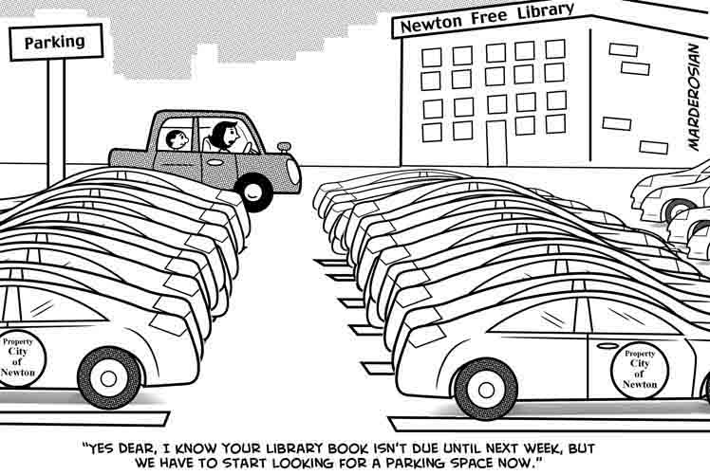
Issue: Looking for parking is a waste of time/gas and causes frustration
Medium Term
Support parking counters at parking garages (may already be considered by TS)
Long Term Solutions
Support efforts by Transportation Services to implement real time parking data showing available parking

