Slide 1
QUEST FOR THE BEST
COMMUNICATIONS TASK FORCE:
RECOMMENDATIONS

Slide 2
Our Team
Our team consisted of:
Phil Carroll, Landscape Maintenance Supervisor
Richard Vaughan, Refrigeration Mechanic
LeAnna Pitts, Asst. Director, Facilities Services
Sandi Henley, Work Control Program Asst.
Melinda Seeley, Campus Planning
Tim Winder, Custodial Services Manager
Alison Hake, Interior Designer, Design & Construction
Anne Schwarz, CPFM

Slide 3
BACKGROUND
We were tasked with investigating the following:
What things or events were folks wanting to know more about?
How successful are existing CPFM communication instruments?
How can we improve top-down, as well as bottom-up, communications?
Are there some good examples of communications in other units?
Many comments suggested periodic updates – what do these look like?

Slide 4
OUR PROCESS
To determine the answers to the previous questions, each member of our team reviewed the session summaries and final report from the Institute for Policy Research & Engagement (IPRE) on the QFTB website. We also researched (within our units) what information people wanted to know more about. One of our members also reached out to two external departments and asked those customers what they would like to see from us. The folks we polled indicated they were pleased with the current communication tools but wanted more up-to-the-minute information.
Over our seven sessions, we evaluated how we can supplement our current communication tools. We discussed ways in which news could be provided in a timely fashion, to avoid misinformation from becoming widespread and to increase the feeling of inclusion.

Slide 5
GOALS
Improve the timeliness of reporting all process and procedure changes to CPFM and, when necessary, to external customers.
Provide staffing changes updates for all CPFM employees within two weeks of the change. This will reduce the rumor mill.
Include all staff by sharing information about projects as they are happening across campus.
Make everyone feel connected to CPFM, regardless of unit or position, by communicating upcoming activities such as building tours, sporting events, museum visits, etc.

Slide 6
FINDINGS
We have surmised that the following items are most desired in the quest for information:
Policy changes / Procedural changes
Staffing hours
Staffing changes with CPFM & FASS – Updates from FASS monthly
Parking updates/changes
Updates on projects
Job opportunities within CPFM
Upcoming tours/events/games for CPFM Participation
The most prevalent request was for more communication from the AVP, directly.

Slide 7
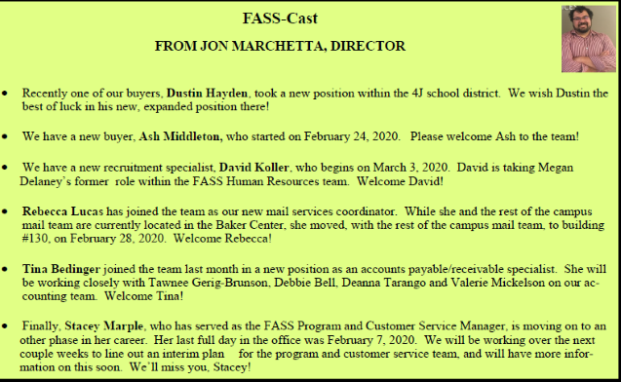
RECOMMENDATION #1
NEWSLETTER
Mike’s Corner
In the current newsletter, provide a 1/4-page block entitled “Mike’s Corner” where the AVP can speak to policy/procedure changes, parking updates/changes, and project updates that pertain to all CPFM. It will include an email address QuestionsforMike@uoregon.edu , which Mike could respond to directly. Providing job opportunities could go here as well.
FASS-Cast
A monthly update from FASS Director, Jon Marchetta with staffing changes for CPFM and FASS. The first one was already in March 2020 newsletter.

Slide 8
RECOMMENDATION #2
MID MONTH EMAIL
Mike Drop
A mid-month email that would provide new and relevant information that arose since the first of the month, such as staffing changes, parking updates, upcoming tours, etc. It would also have the email so that questions and concerns could be addressed: QuestionsforMike@uoregon.edu
This email also serves as a bottom-up communication tool and would be added to the website as a link, as well, so folks could refer to it whenever necessary.

Slide 9
RECOMMENDATION #3
BOTTOM UP COMMUNICATION
Ongoing Shop Visits
The AVP has started having shop visits within Facilities Services and Utilities & Energy.
These are being expanded upon to include all units on a rotating basis.

Slide 10
IN CONCLUSION
Our recommendations will provide the following four means of communication from Administration to CPFM employees:
NEWSLETTER WITH FASS-CAST
“Mike’s Corner” with designated email address entitled: QuestionsforMike@uoregon.edu – online / emailed / printed
MID-MONTH EMAIL
“Mike Drop” with QuestionsforMike@uoregon.edu for questions and concerns
WEBSITE
Links to the above
SOCIAL MEDIA
Instagram / Twitter

