Slide 1
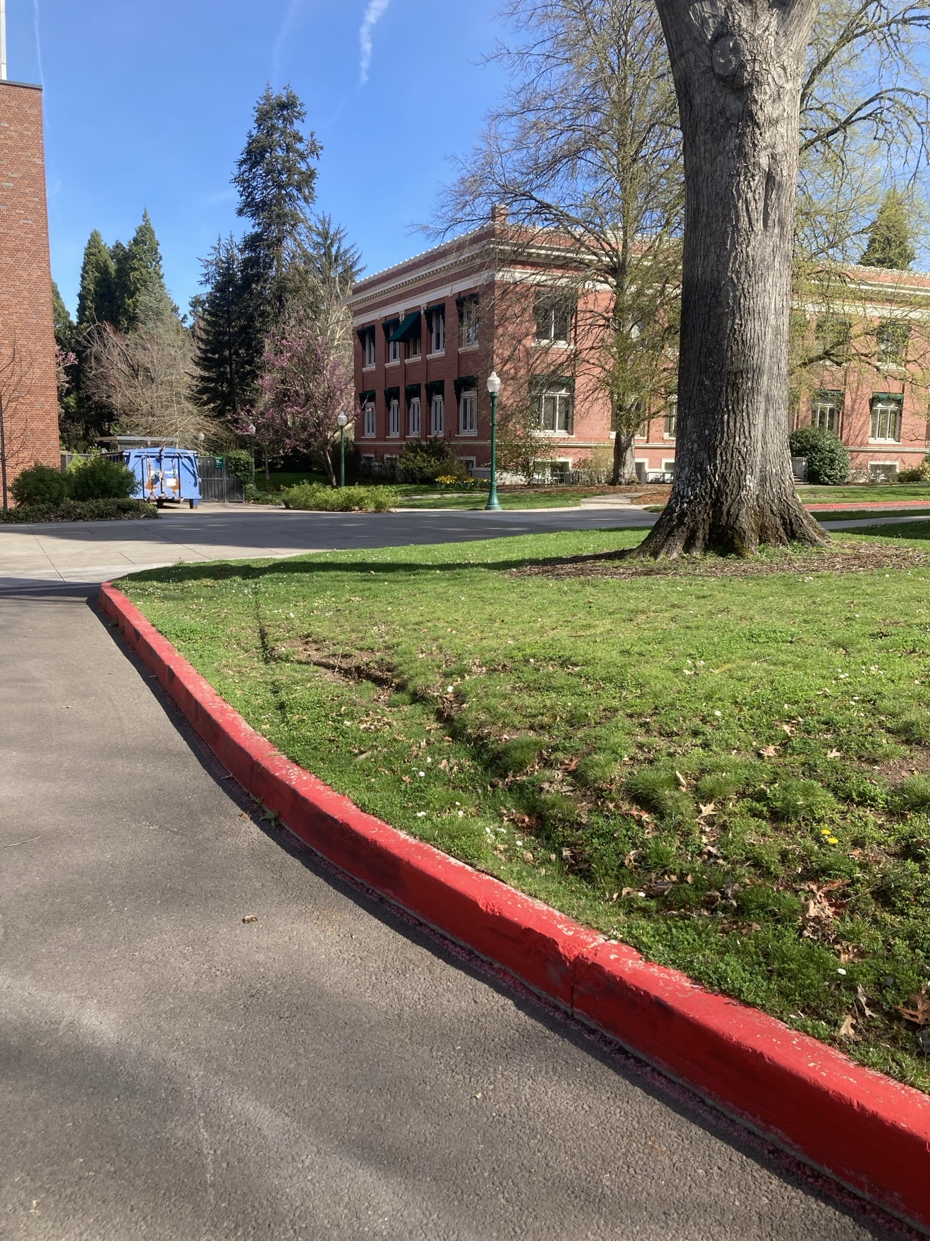
Campus Landscape Damage
By Kevin Farthing & Tim Winder

Slide 2

U of O Landscape as Asset
Recruiting tool
Community jewel
Over a million dollars of ongoing maintenance costs……
Nexus between the academic & natural worlds
Used as teaching & study space

Slide 3
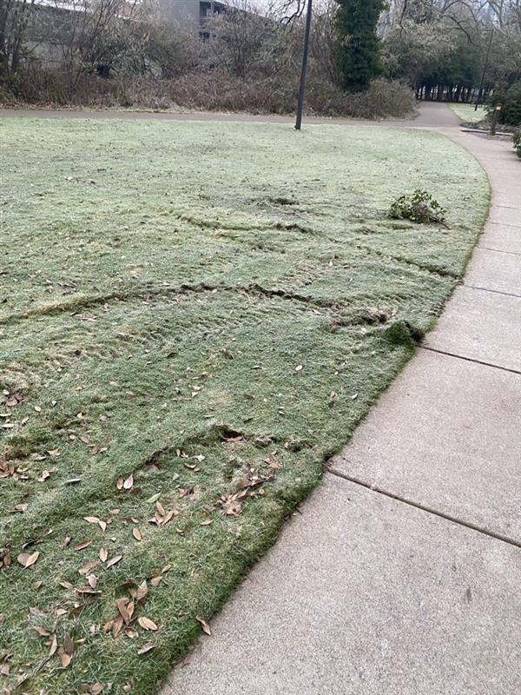
Damage Happens….
For a variety of reasons:
  Winter and shoulder months
  Inappropriate vehicles on paved walkways
  Lifts
  Not using track mats
  Sub-optimal design
  Vendors
  Students – hammocks

Slide 4
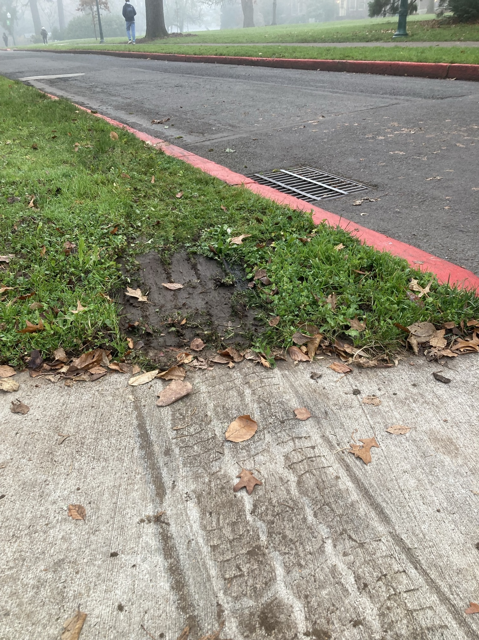
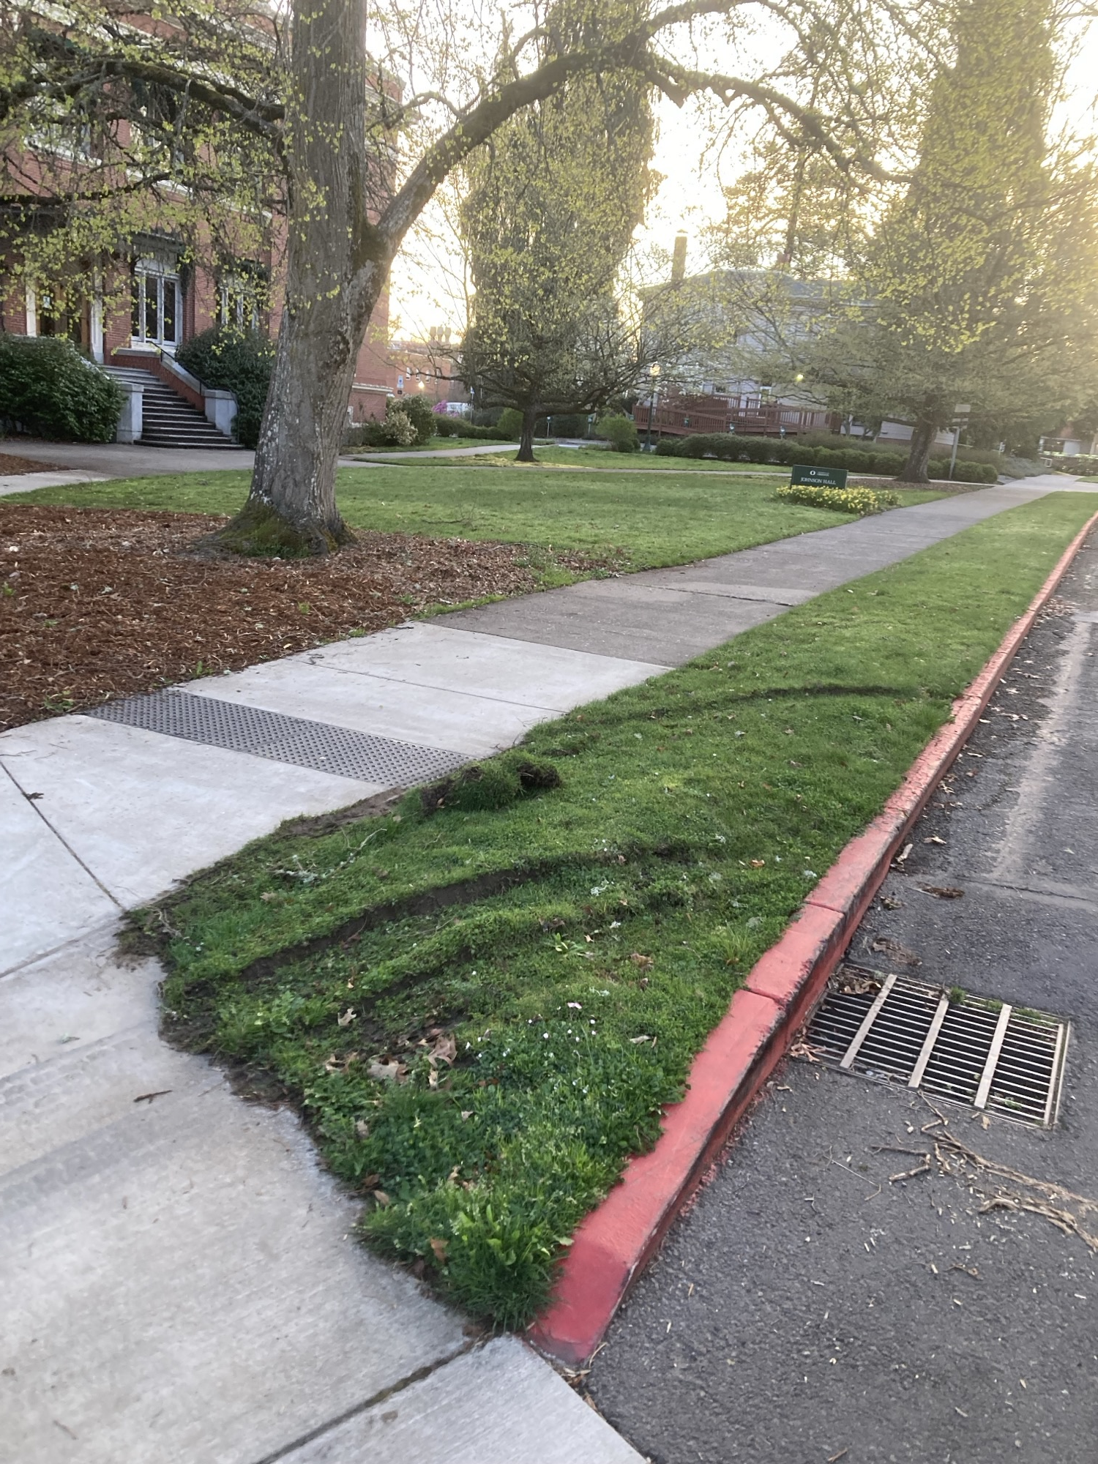
More Examples….

Slide 5
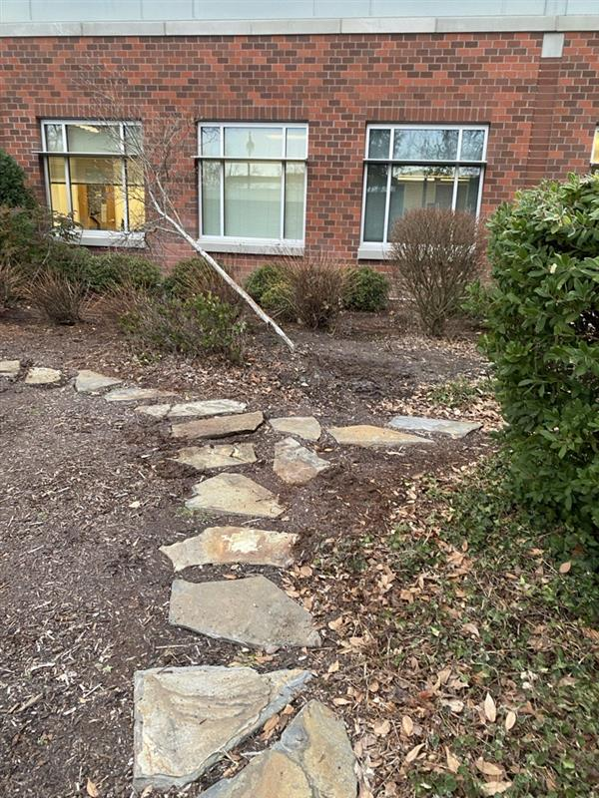
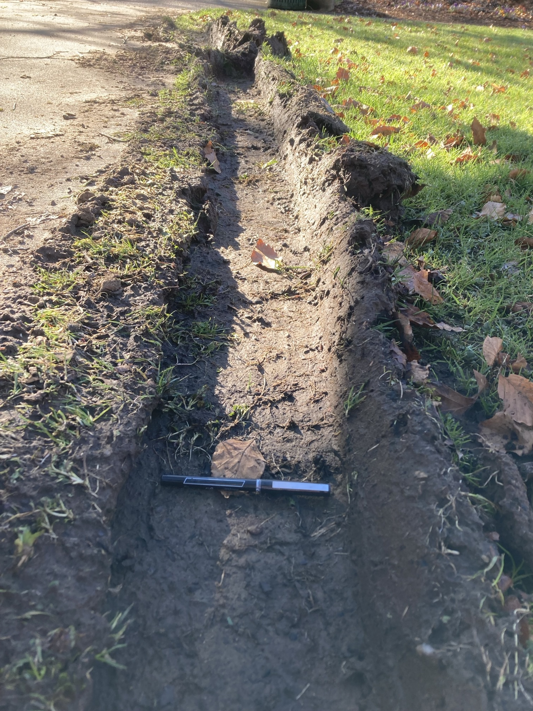
And Yet More Examples…..

Slide 6

What can we do?
Please talk to your:
  Employees
  Vendors
  Student workers
……about being mindful!
If we damaged a building in the same way…..
If you do happen to damage the landscape….
  Contact Work Control
  Contact the landscaping team

Slide 7
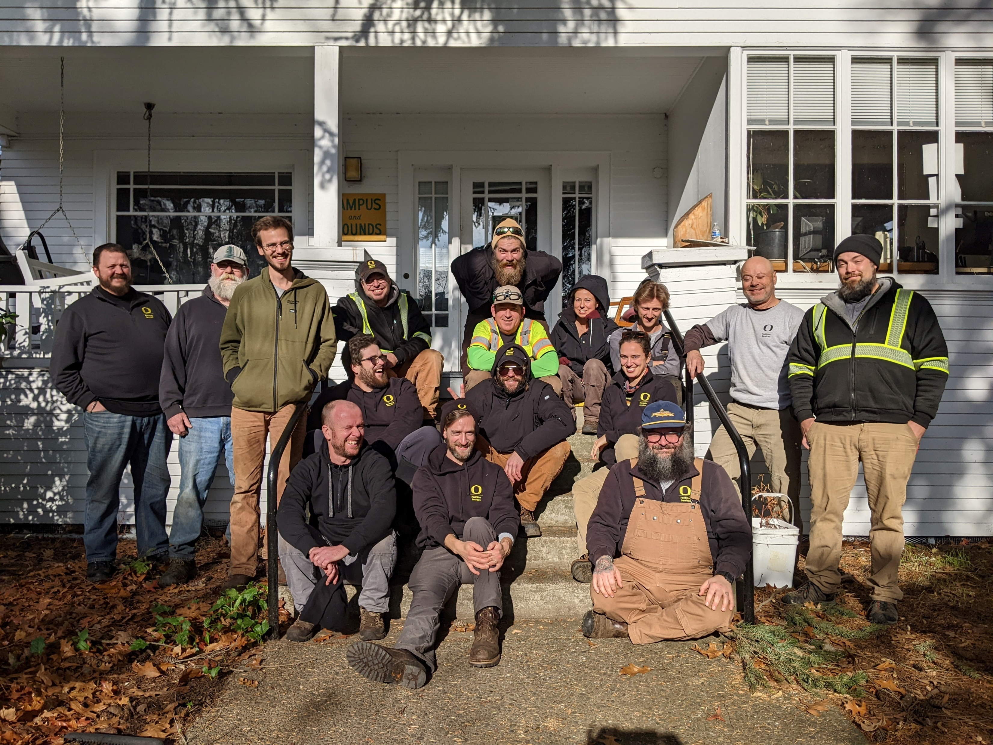
We can fix the damage…..
…..but we’d rather not…
…and focus on detailed work that makes the campus beautiful, and…
……we may need to charge you

Slide 8
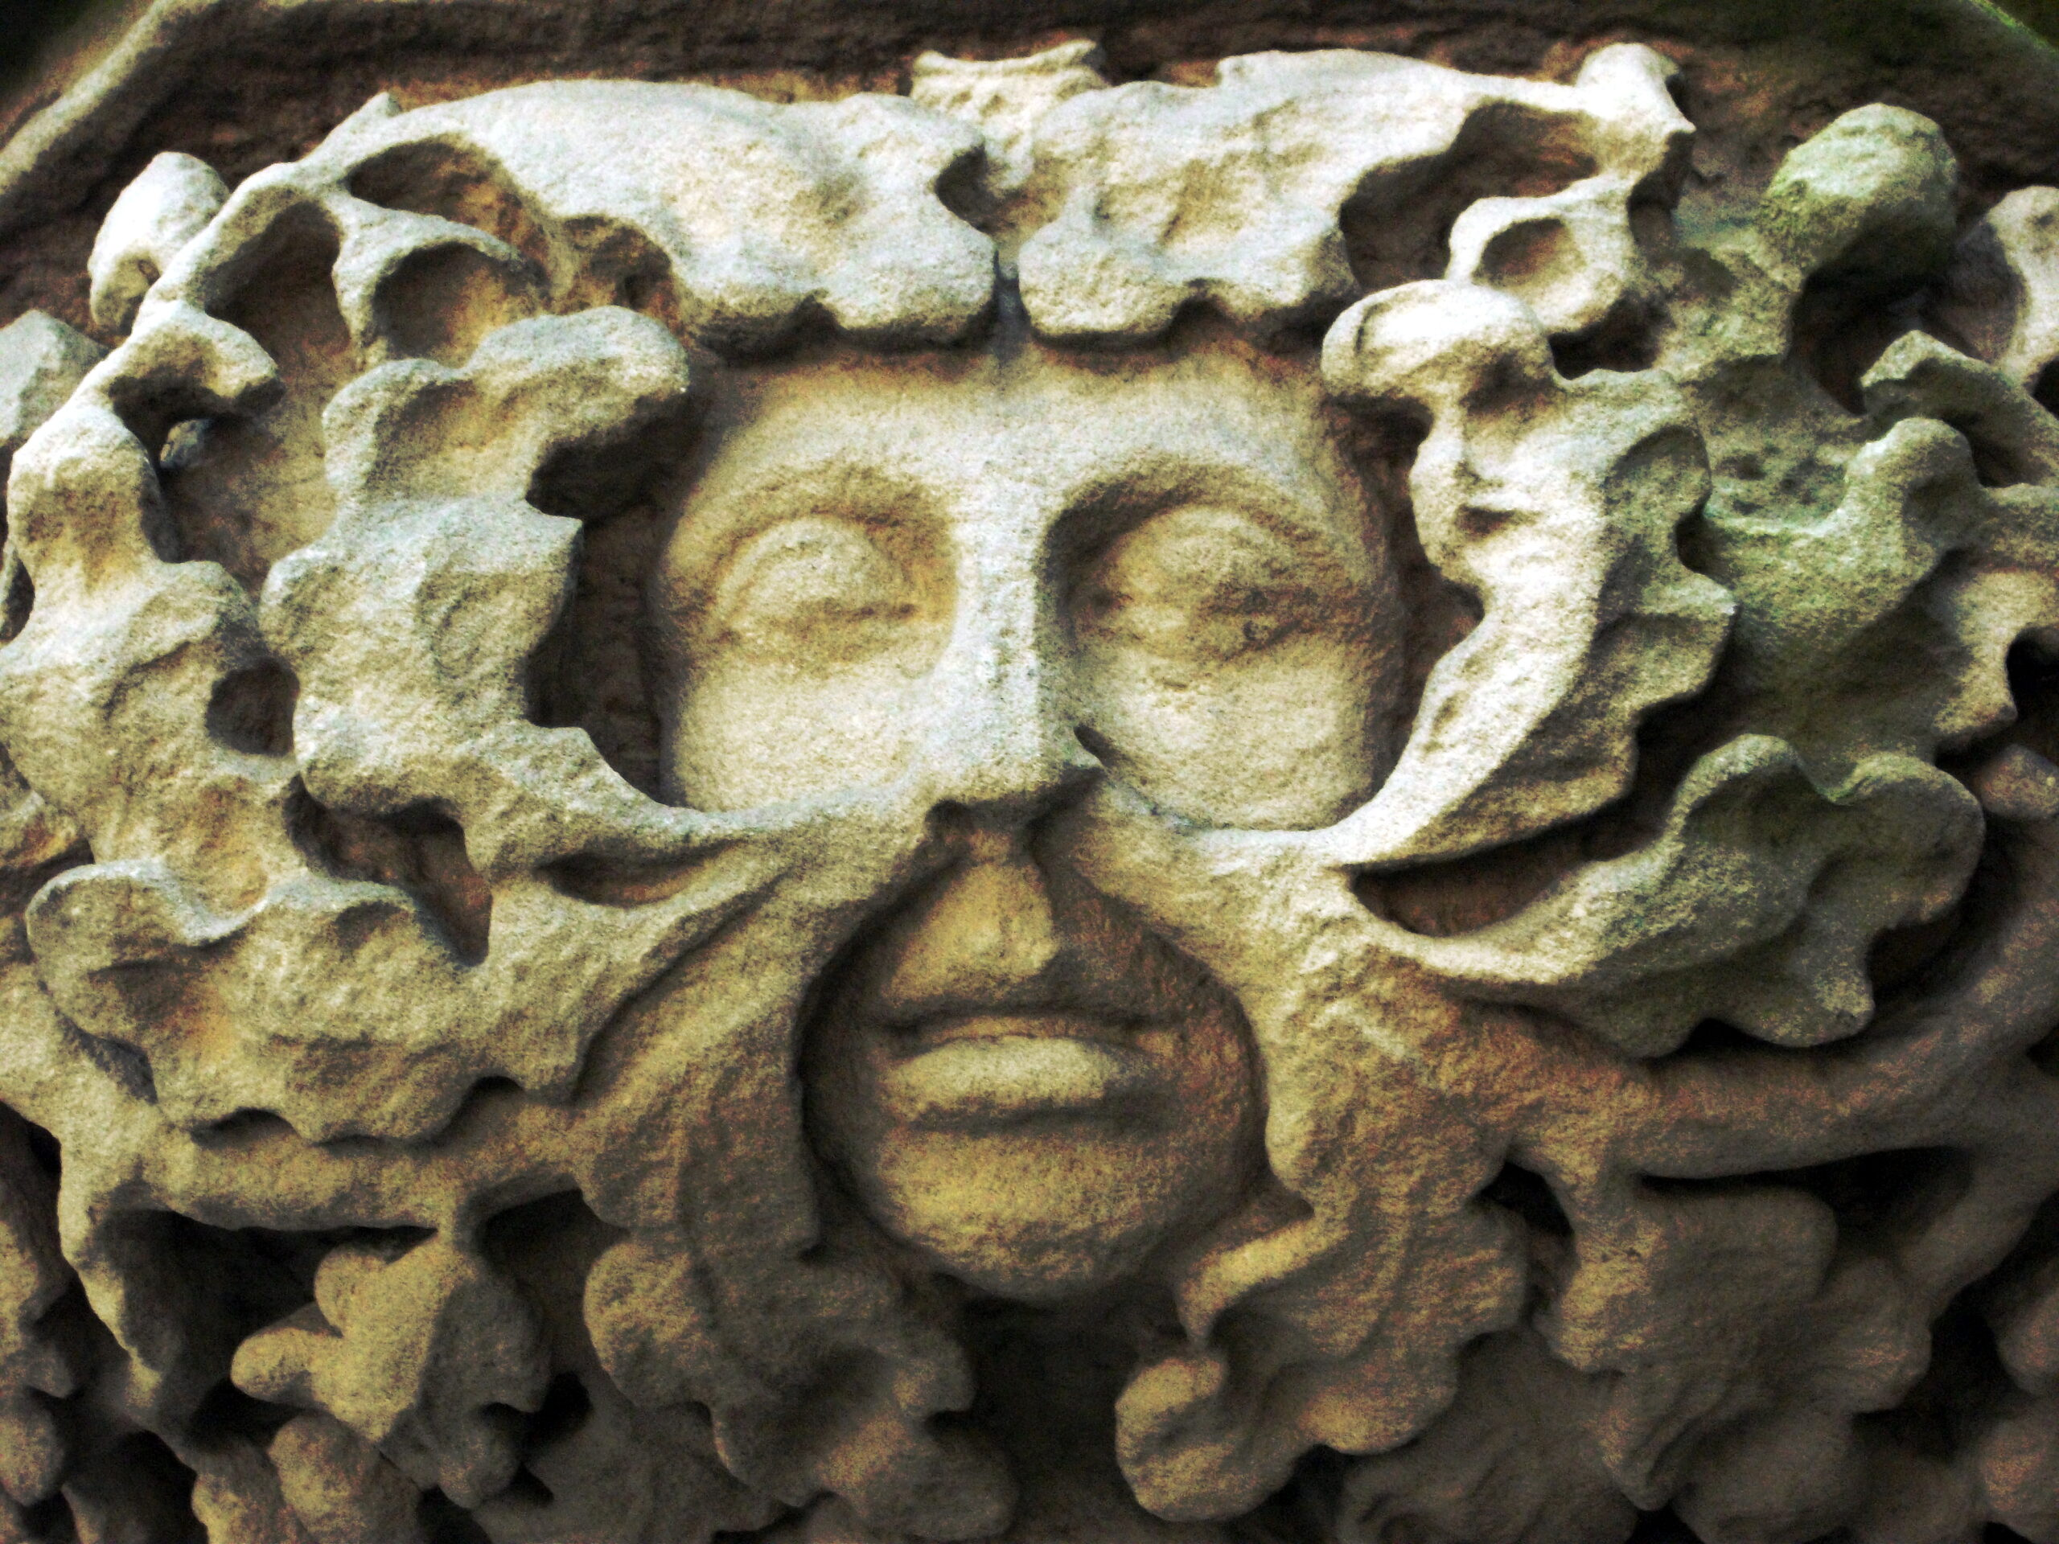
Questions/Thoughts

