Slide 1
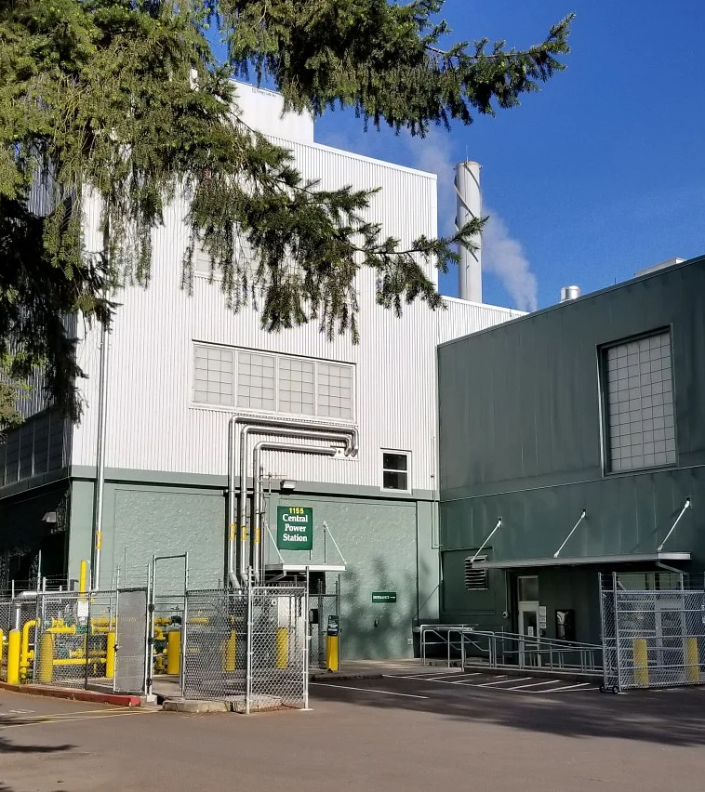
August 2026 Electrical Testing Plan
University of Oregon
May 5, 2026

Slide 2

August 2026 Electrical Testing Plan (Island Mode)
University of Oregon
May 5, 2026

Slide 3
Agenda
Central Power Station upgrades
Mitigation Plan
Timeline

Slide 4
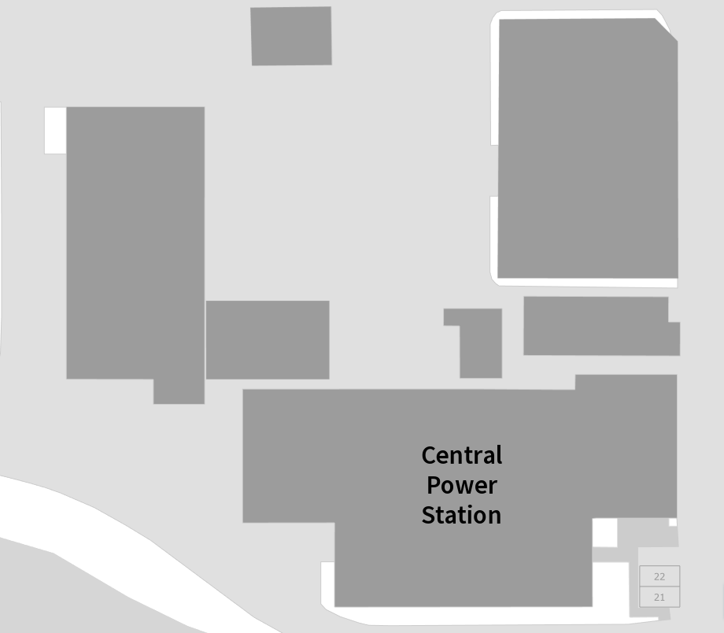
115 KV from
Adams
substation
115 KV from
Willamette
substation
Existing Resiliency Features
Two EWEB feeds
Three diesel generators (6.6 MWs)
Diesel Storage
Turbine Generator (8 MWs)
Twelve feeders to campus buildings
Thermal Storage
Y
Y
81,000 gallon
diesel storage
Chiller
Plant
UO
Sub-Station
Back-up
Diesel Generators
3 million gal
Thermal Energy Storage
Switch House
BUS A
BUS B
Feeders to campus
CTG
boilers
Central
Power
Station

Slide 5
115 KV from
Adams
substation
115 KV from
Willamette
substation
Existing Resiliency Features
Two EWEB feeds
Three diesel generators (6.6 MWs)
Diesel Storage
Turbine Generator (8 MWs)
Twelve feeders to campus buildings
Thermal Storage
Y
Y
81,000 gallon
diesel storage
Chiller
Plant
UO
Sub-Station
Back-up
Diesel Generators
3 million gal
Thermal Energy Storage
New Features
Fourth Diesel Generator (3 MWs)
Local Generator Control panels
Generator Industrial Controls
Additional Feeder redundancy
Electric meters for Streisinger and Willamette
Switch House
BUS A
BUS B
Feeders to campus
CTG
boilers
Central
Power
Station

Slide 6
August 6-7
Install controls on
Gens 3 and 4.
No campus impact.
August 10-11
Test/ Synch Gens 3 and 4
Install controls on
Gens 1 and 2
No Campus Impact
August 12
Test and Export power
to campus from Gens
Expect Short Outages
August 13
Island Mode Tests
Expect Short Outages

Slide 7
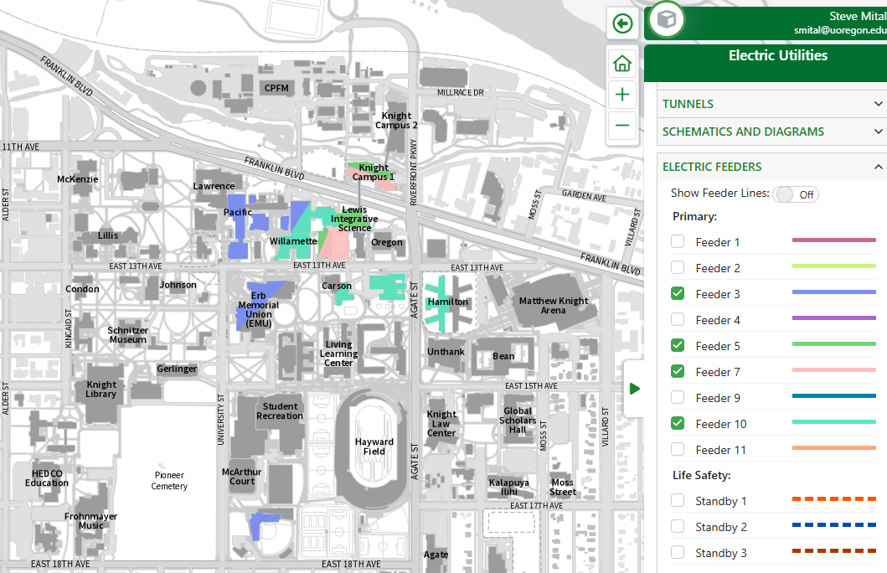
Science Complex Mitigation Plan
  Re-route Klamath, Pacific, Columbia, Willamette and Streisinger to Feeders 5 and 7
  Rent 7 Temporary Generators
  Connect Temp Generators to Feeders 5 and 7
Knight
Campus 2

Slide 8
Science Complex Mitigation Plan
  Re-route Klamath, Pacific, Columbia, Willamette and Streisinger to Feeders 5 and 7
  Rent 7 Temporary Generators
  Connect Temp Generators to Feeders 5 and 7
Knight
Campus 2

Slide 9
Science Complex Mitigation Plan
  Re-route Klamath, Pacific, Columbia, Willamette and Streisinger to Feeders 5 and 7
  Rent 7 Temporary Generators
  Site Temp Generators at Knight Construction Parking lot
  Connect Temp Generators to Feeders 5 and 7
Data Centers Plan
  Rent diesel Generators
  Note: These only power data centers, not other building functions in Oregon Hall, Allen Hall, and Computing Center
ZIRC Plan
  Move from Standby to Feeder 1
Knight
Campus 2

Slide 11
Timeline
  March – May Cutover Klamath, Pacific, Columbia, Willamette and Streisinger
  July Cutover ZIRC to Feeder 1
  August 3-7 Install temporary generators
  August 6-7 U&E commissioning and testing begins
  August 10 Start temp generators for Feeders 5 and 7
  August 10-11 Continue U&E commissioning and testing –
  August 12-13 Island Mode testing (7am to 7pm).
  August 14 Remove Temporary generators from Feeders 5 and 7

Slide 12
Questions

