Slide 1
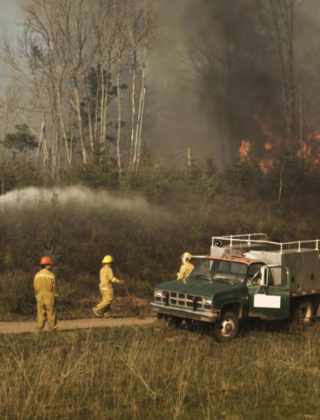
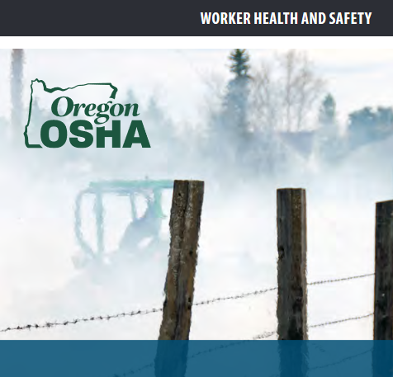
Working with
Wildfire Smoke
Photo credit: OR-OSHA publication

Slide 2
2026
Oregon-OSHA Wildfire Smoke
Rule
Oregon Administrative Rule 437-004-9791
Employees performing work with unhealthy exposure to wildfire smoke. Particulate Matter (PM2.5) ≥ 35.5 micrograms per cubic meter, aka AQI ≥ 101.
Some exemptions,
  Employees working from home
  Affected employer operations that are suspended until conditions improve
  Employees working inside mechanically filtered enclosures, with opening normally kept closed
  {Partial} Incidental exposures, exposed <15 minutes per 60 minutes per 24-hour period
  {Partial} Life/Safety emergency conditions & associated operations
Notes:
Employee-focused. Any employee predominately working outdoors during affected periods.
Employee training & voluntary use of respirators (must be allowed) at AQI > 100 (Unhealthy for Sensitive Groups)
Training can occur now. Impact of voluntary use likely low? Already allowed due to COVID-19 rules.
Employees required to use respirators at AQI > 200 (Very Unhealthy)
Impact of required use of respirators may be high. Particularly if televised outdoor event. UO employees vs. non-UO employees with opposing team.
Temporary emergency rule for 2021 fire season, effective August 9th. OR-OSHA had permanent rule-making underway; that should result in future permanent Oregon requirements effective 2022.

Slide 3
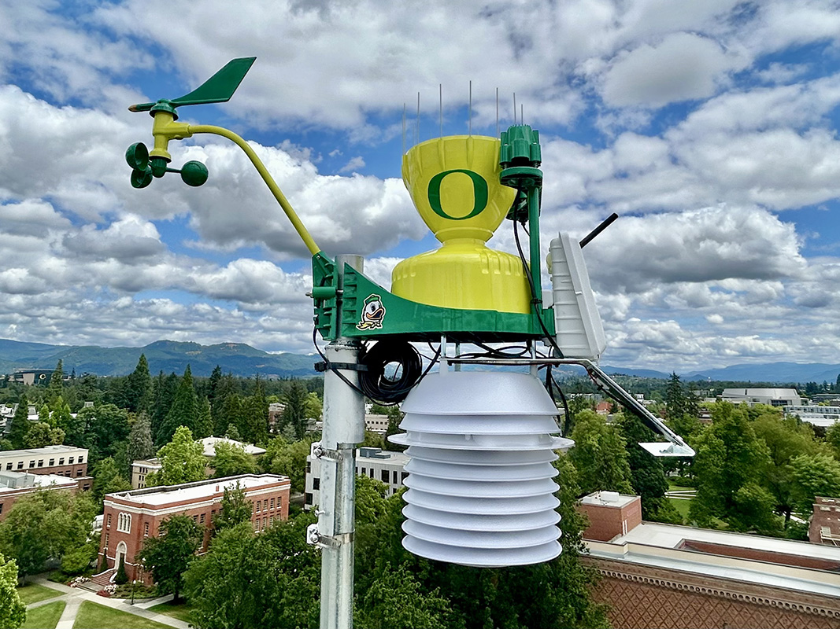
2026
UO's New Weather Station
Notes:
Employee-focused. Any employee predominately working outdoors during affected periods.
Employee training & voluntary use of respirators (must be allowed) at AQI > 100 (Unhealthy for Sensitive Groups)
Training can occur now. Impact of voluntary use likely low? Already allowed due to COVID-19 rules.
Employees required to use respirators at AQI > 200 (Very Unhealthy)
Impact of required use of respirators may be high. Particularly if televised outdoor event. UO employees vs. non-UO employees with opposing team.
Temporary emergency rule for 2021 fire season, effective August 9th. OR-OSHA had permanent rule-making underway; that should result in future permanent Oregon requirements effective 2022.

Slide 4
2026
UO's New Weather Station
Located on top of PLC
Includes sensors to read proximity of lightning strikes, air quality, temperature, and wind speed
Radar and Satellite monitoring of weather in the region
Hourly forecasts
Daily time lapse video
And more!
Notes:
Employee-focused. Any employee predominately working outdoors during affected periods.
Employee training & voluntary use of respirators (must be allowed) at AQI > 100 (Unhealthy for Sensitive Groups)
Training can occur now. Impact of voluntary use likely low? Already allowed due to COVID-19 rules.
Employees required to use respirators at AQI > 200 (Very Unhealthy)
Impact of required use of respirators may be high. Particularly if televised outdoor event. UO employees vs. non-UO employees with opposing team.
Temporary emergency rule for 2021 fire season, effective August 9th. OR-OSHA had permanent rule-making underway; that should result in future permanent Oregon requirements effective 2022.

Slide 5
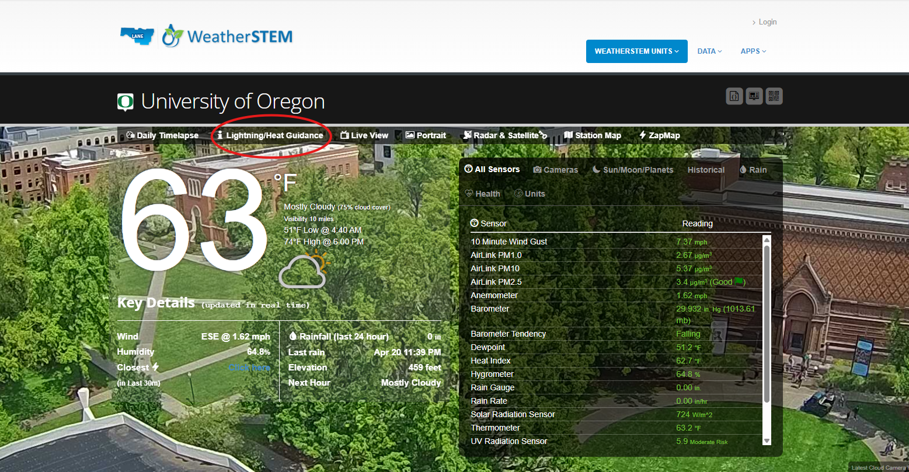
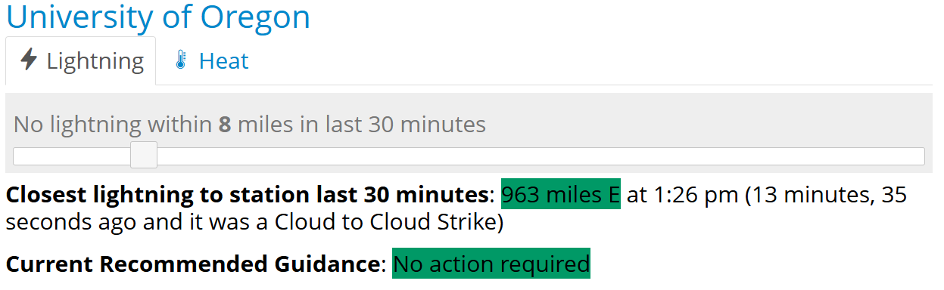
2026
Lightning
Notifications
Update
- No longer notifying about lightning in the area.
Please use the weather station to track proximity of lightning strikes.
Notes:
Employee-focused. Any employee predominately working outdoors during affected periods.
Employee training & voluntary use of respirators (must be allowed) at AQI > 100 (Unhealthy for Sensitive Groups)
Training can occur now. Impact of voluntary use likely low? Already allowed due to COVID-19 rules.
Employees required to use respirators at AQI > 200 (Very Unhealthy)
Impact of required use of respirators may be high. Particularly if televised outdoor event. UO employees vs. non-UO employees with opposing team.
Temporary emergency rule for 2021 fire season, effective August 9th. OR-OSHA had permanent rule-making underway; that should result in future permanent Oregon requirements effective 2022.

Slide 6
2026
Air Quality Notifications
Update
- What official tools are used to assess air quality at UO?
  Eugene Campus – lane.weatherstem.com/uo
  Other work locations – www.airnow.gov for area zip code
- UO Air Quality Notifications:
  NEW! 1x daily Air Quality Notification model via UO Weather Station:
    > 35.5 micrograms per cubic meter ( > 101 AQI)
    Text and Email – only between 6am – 6pm daily
  WHO needs to know?
    Supervisors of outdoor employees
    Work Control Centers
    Duty Administrators
    BAS – to adjust HVAC systems to recirculation modes
Notes:
Employee-focused. Any employee predominately working outdoors during affected periods.
Employee training & voluntary use of respirators (must be allowed) at AQI > 100 (Unhealthy for Sensitive Groups)
Training can occur now. Impact of voluntary use likely low? Already allowed due to COVID-19 rules.
Employees required to use respirators at AQI > 200 (Very Unhealthy)
Impact of required use of respirators may be high. Particularly if televised outdoor event. UO employees vs. non-UO employees with opposing team.
Temporary emergency rule for 2021 fire season, effective August 9th. OR-OSHA had permanent rule-making underway; that should result in future permanent Oregon requirements effective 2022.

Slide 7
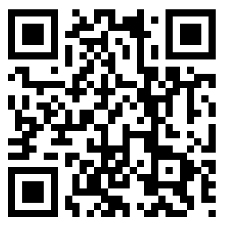
2026
Supervisor Responsibilities
- Supervisor Responsibilities of Outdoor Employees :
  Adjustments to Work protocols for Exposed Employees (supervisors’ following training)
  Take the training for Exposed Employees on wildfire smoke hazards and controls: https://safety.uoregon.edu/wildfire-smoke
  N95 Reminder: A respirator! (EHS consultation required to wear N95s outside of wildfire smoke events)
  Bookmark the UO weather station and monitor!
Notes:
Employee-focused. Any employee predominately working outdoors during affected periods.
Employee training & voluntary use of respirators (must be allowed) at AQI > 100 (Unhealthy for Sensitive Groups)
Training can occur now. Impact of voluntary use likely low? Already allowed due to COVID-19 rules.
Employees required to use respirators at AQI > 200 (Very Unhealthy)
Impact of required use of respirators may be high. Particularly if televised outdoor event. UO employees vs. non-UO employees with opposing team.
Temporary emergency rule for 2021 fire season, effective August 9th. OR-OSHA had permanent rule-making underway; that should result in future permanent Oregon requirements effective 2022.

Slide 8
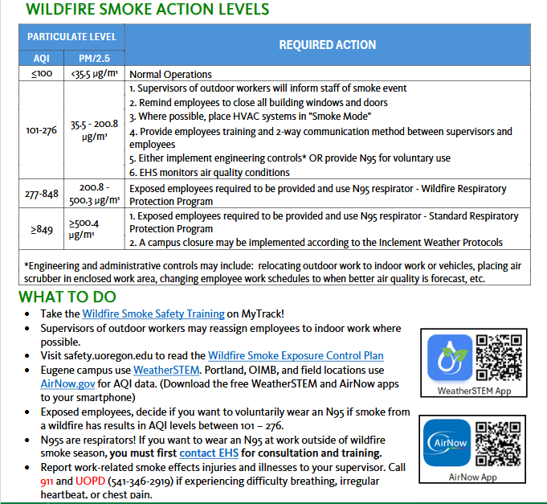
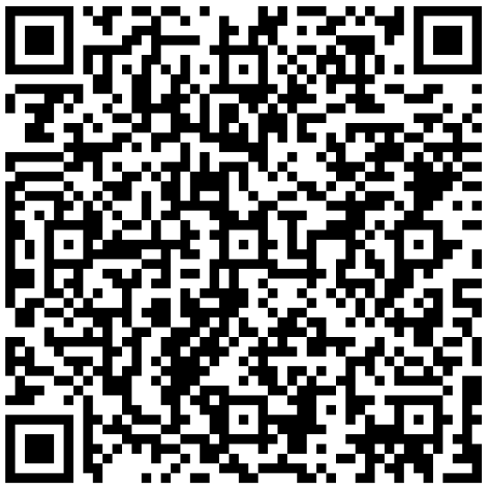
2026
Wildfire Smoke
Exposure Safety Sheet
Notes:
Employee-focused. Any employee predominately working outdoors during affected periods.
Employee training & voluntary use of respirators (must be allowed) at AQI > 100 (Unhealthy for Sensitive Groups)
Training can occur now. Impact of voluntary use likely low? Already allowed due to COVID-19 rules.
Employees required to use respirators at AQI > 200 (Very Unhealthy)
Impact of required use of respirators may be high. Particularly if televised outdoor event. UO employees vs. non-UO employees with opposing team.
Temporary emergency rule for 2021 fire season, effective August 9th. OR-OSHA had permanent rule-making underway; that should result in future permanent Oregon requirements effective 2022.

