Slide 1
Millrace Economics
By Brian Mayne

Slide 2
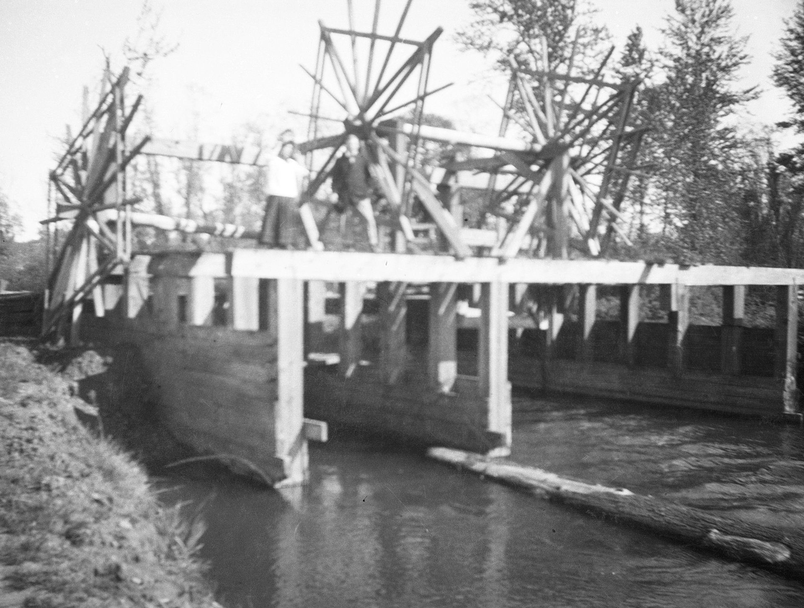
Establishment
Established in 1851 by Hilyard Shaw, who connected two Willamette River sloughs.
Shaw built a sawmill and grist mill.
By the late 19th century, hosted a dozen separate industries.
Helped Eugene to surpass Springfield and stay a separate city.
http://www.otiabridge.org/historic-preservation/

Slide 3
Initial Problems
Flooding in 1890, 1891, 1902, 1904, and several times in the 1940’s.
Irregular fires (though this wasn’t unique).
Homeowners complaints during renovation to increase flow to the Chambers power company in 1910.
Chambers lost property, time, and money due to the six year litigation.
Industry abandoned the race by 1928.

Slide 4
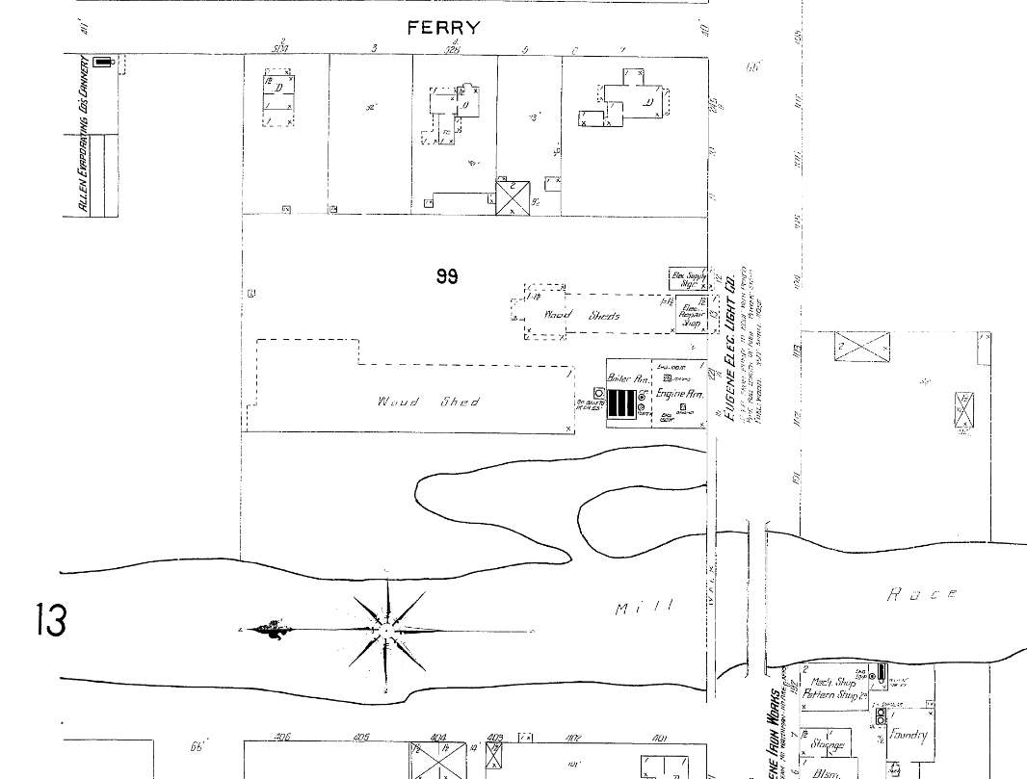
Never a Bright Future
Most industries simply processed agricultural and horticultural products.
Other industries (furniture factory, repair shop, energy storage, ect.) only supplied local demand.
Millrace never evolved out of Oregon’s agricultural economy.
Woolen mill and excelsior companies were possible exceptions, but they left in 1928 due to flooding and cheap electricity.
http://sanborn.umi.com.libproxy.uoregon.edu/or/7358/dateid-000006.htm?CCSI=2197n. 1902 map of the millrace, showing only wood sheds and a small electric plant remaining at this location.

Slide 5
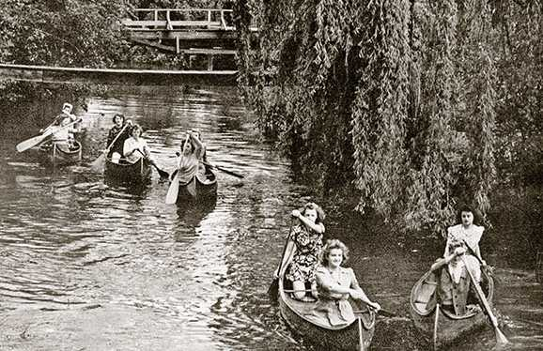
Later Use
Some restaurants were built along the banks.
Canoe rental facility for student races and various festivals.
Incorporation into the street drainage system.
Plans for renovation, starting with increased water flow.
http://www.oregonquarterly.com/class-notes-autumn-2014

Slide 6
Problems with Renovation
One 30” pipe supplies the race. Isn’t even used to full potential.
Adding a 42” pipe would cost $220,000 plus the cost of a self regulating engine.
Adding a second pump would cost $130,00 and $600 a month in maintenance.
Reestablishing gravity flow, and preventing future floods, between 3.7 and 4.6 million dollars.
Repair costs in the 1970’s, before further infrastructural degredation.

Slide 7
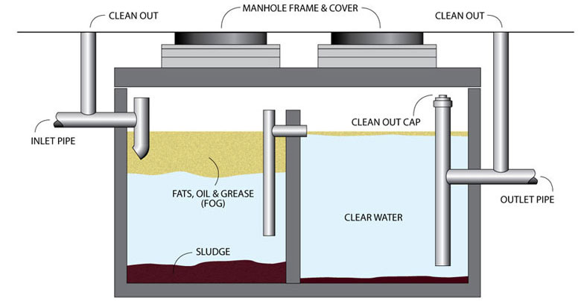
Further Renovation Costs
Installation of grease traps and their maintenance: $3,200/year
General cleanup and debris removal: $32,000 without volunteers
Surveying and mapping for modern conditions: $96,000
Advertisement: unknown, but necessary for economic revitalization
http://www.gogreenli.com/grease.html

Slide 8
Issues with Solutions
Appeals during the 1970’s for alumni volunteers and donors.
Many offered assistance, but it was never enough. Lack of faith in getting results for many potential donors.
Lack of millrace memories for modern alumni and students. Doubtful that many would offer help now.

Slide 9
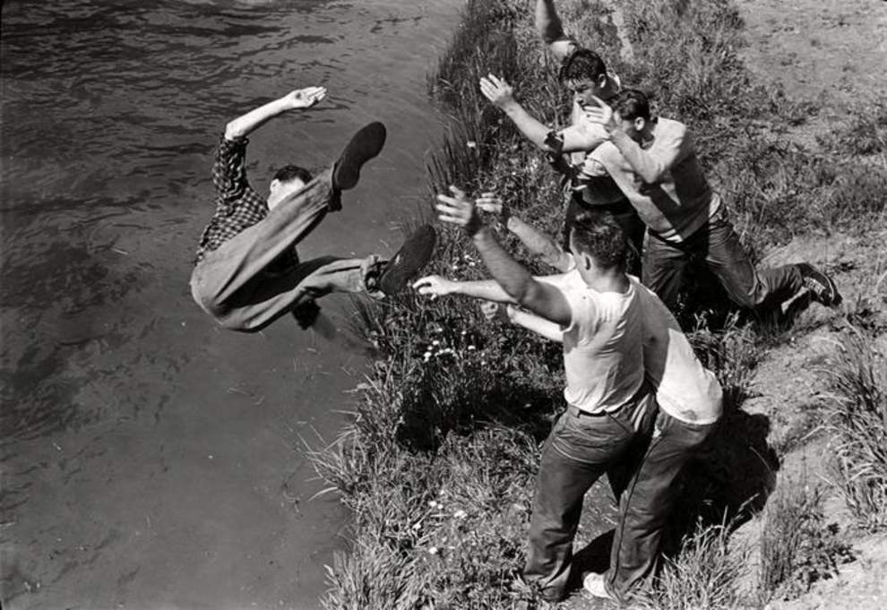
Legal Problems
Lower race owned by private property owners.
Legal negotiation would require money, long negotiation, and compromise with regards to plans. Too many interests involved.
Buyup of the property and redirection of the race similarly economically unfeasible.
Nearly all developers saw the lack of lower race ownership as an issue for redevelopment of any kind.
Possibility of drowning if flow is increased. City, university, or private businesses could be sued, depending on circumstance.
http://registarguard.com, dt.common.streams.StreamServer.cls pdf file

Slide 10
Conclusions
Initial costs, plus maintenance, cannot justify rebuilding for economic purposes, especially given that it may fail to attract business.
Any redevelopment could only be justified from a cultural standpoint, like the Eiffel Tower or Statue of Liberty.
Might help give the city of Eugene a stronger identity as a city.
Would give the city and university a beautiful scenic area for relaxation too.
No one should expect it to turn a profit though. It never really did except in the very beginning.

Slide 11
Citations
Gill, Jerry, Sharon Otremva, Judith Rees, and Grace Wingfield. "Eugene Millrace, A History." Published by the City of Eugene, Housing and Community Conservation Department, May 6, 1979.
Robbins, William G. Landscapes of promise: the Oregon story, 1800-1940. Seattle: U of Washington Press, 1997.
Willingham, William F., PH.D. "A Historical Context for the Eugene Millrace and Intake Structures." February 26, 2010, https://scholarsbank.uoregon.edu/xmlui/bitstream/handle/1794/18653/EugeneMillraceIntakeStructures_HistoricalContext_20100226.pdf?sequence=1
Thomas, Bob, Gordon Brunton, and Priscilla McKeigue. “A Research Report: The Eugene Millrace.” Eugene, OR: The Metropolitan Civic Club, 1966.
Tweedell, Bob. "Millrace History." Eugene Register Guard, 1949.
Sanborn Maps. 1902, Eugene, Oregon. Provided by http://sanborn.umi.com.libproxy.uoregon.edu/splash.html from the University of Oregon.
Office of the President Robert D. Clark Records, University of Oregon Knight Library Archives, Box 29 Folders 10-11, Box 59 Folders 8-10, Box 76 Folder 14, Box 90 Folder 5, Box 111 Folders 21-23, Box 132 Folder 10.
Officer of the President Jones and Flemming Records (1965-1966), University of Oregon Knight Library Archives, Box 122 Folder 14, Box 159 Folder 14.

