Slide 1

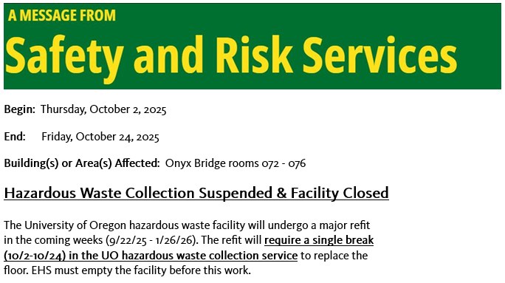
Safety and Risk Services
Environmental Health & Safety

Slide 2
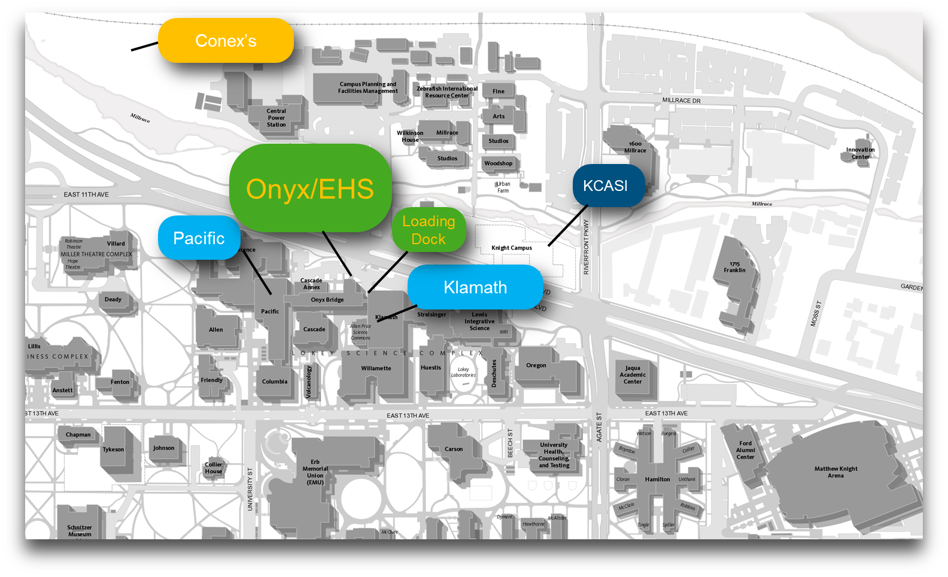
Safety and Risk Services
Environmental Health & Safety
Notes:
~4000 sq ft, spread over 5 buildings and a mile of distance.
Typical annual average of 30,000 lbs chemical material and 12,000 to 40,000 lbs biohazardous material moving through Onyx Facility. Range on annual total regulated waste handled all operations is 40,000 to 100,000 lbs. Largest recurring institutional contributor of regulated waste is research and teaching laboratories + College of Design, then CPFM, then Housing Facilities.
Central nature of EHS/Onyx facility creates efficiencies that minimize staffing and S&S requirements
Operations provided by 3 personnel: 1 manager and 2 classified staff

Slide 3
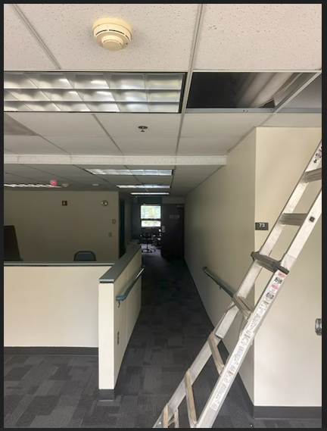
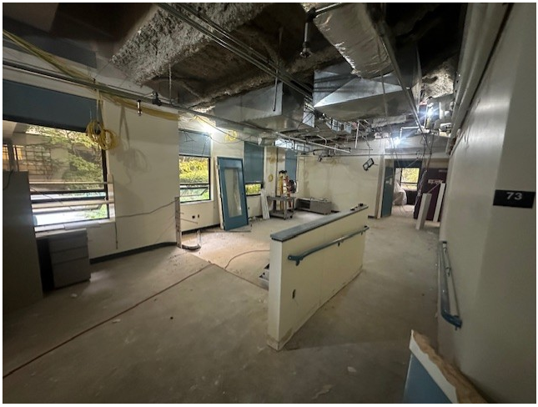
Safety and Risk Services
Environmental Health & Safety

Slide 4
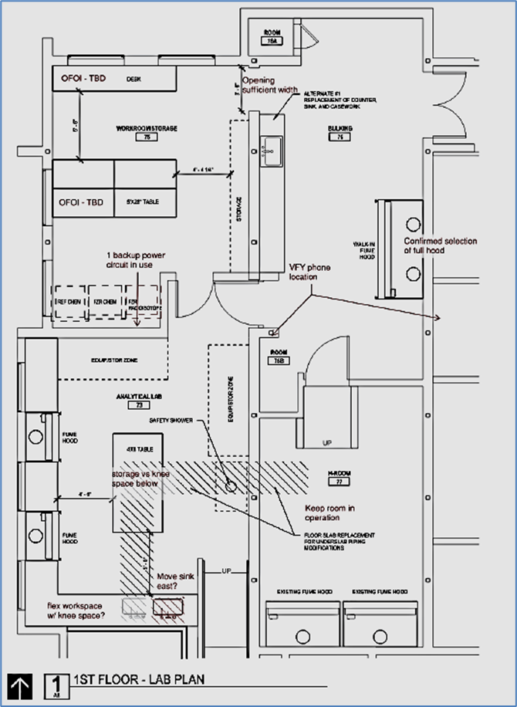
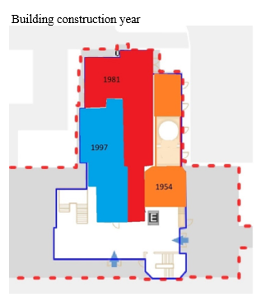
Safety and Risk Services
Environmental Health & Safety

Slide 5
Questions?
Safety and Risk Services
Environmental Health & Safety

