Slide 1
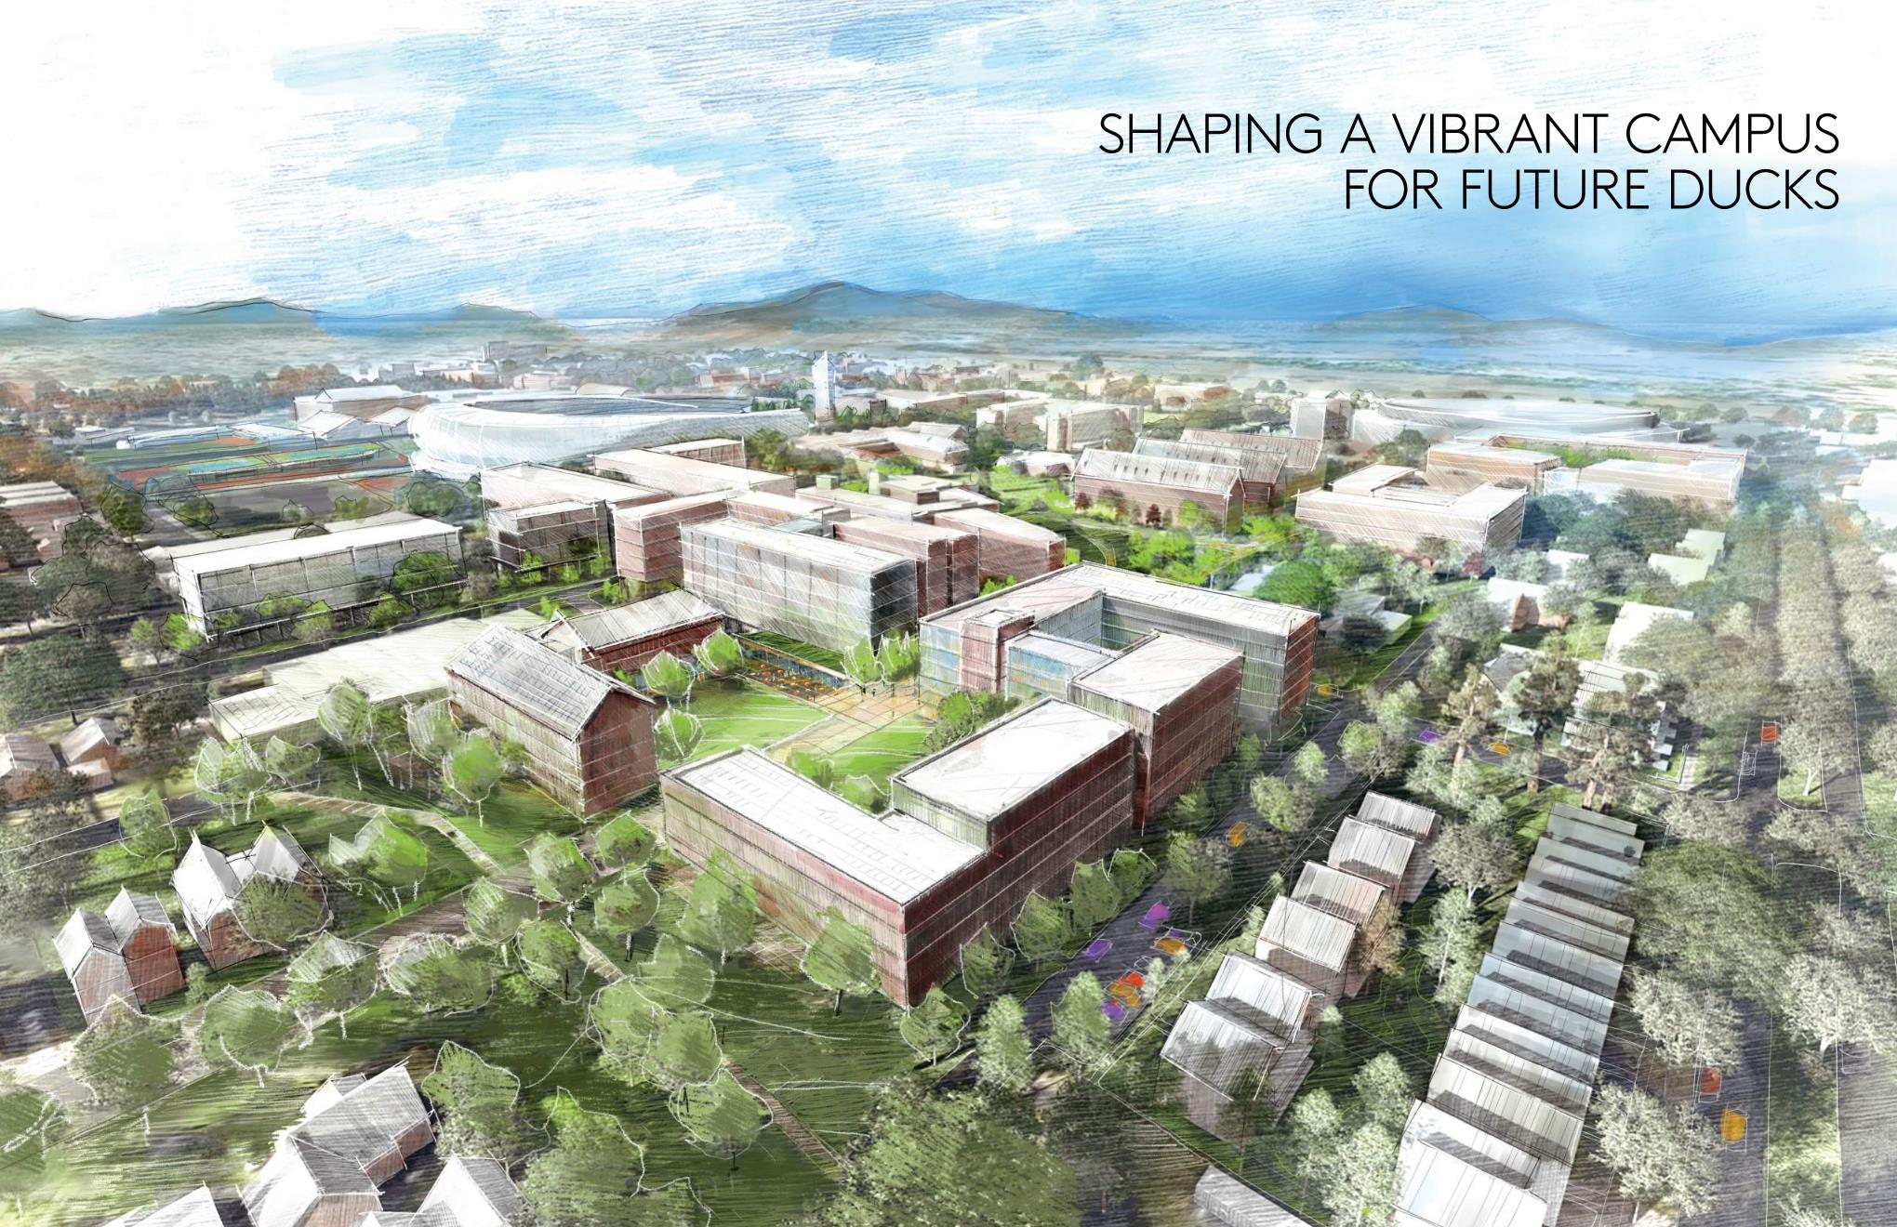
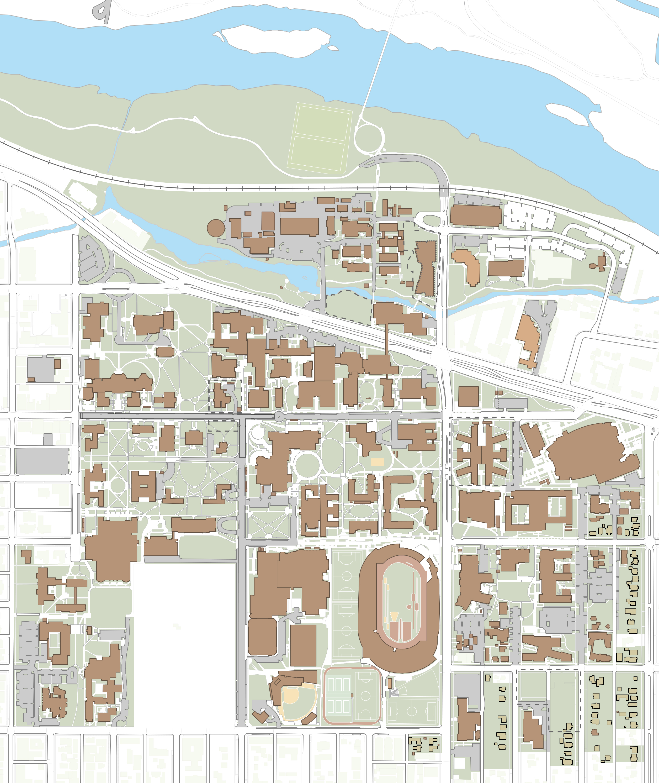
Next Generation Development Plan
Map

Slide 2
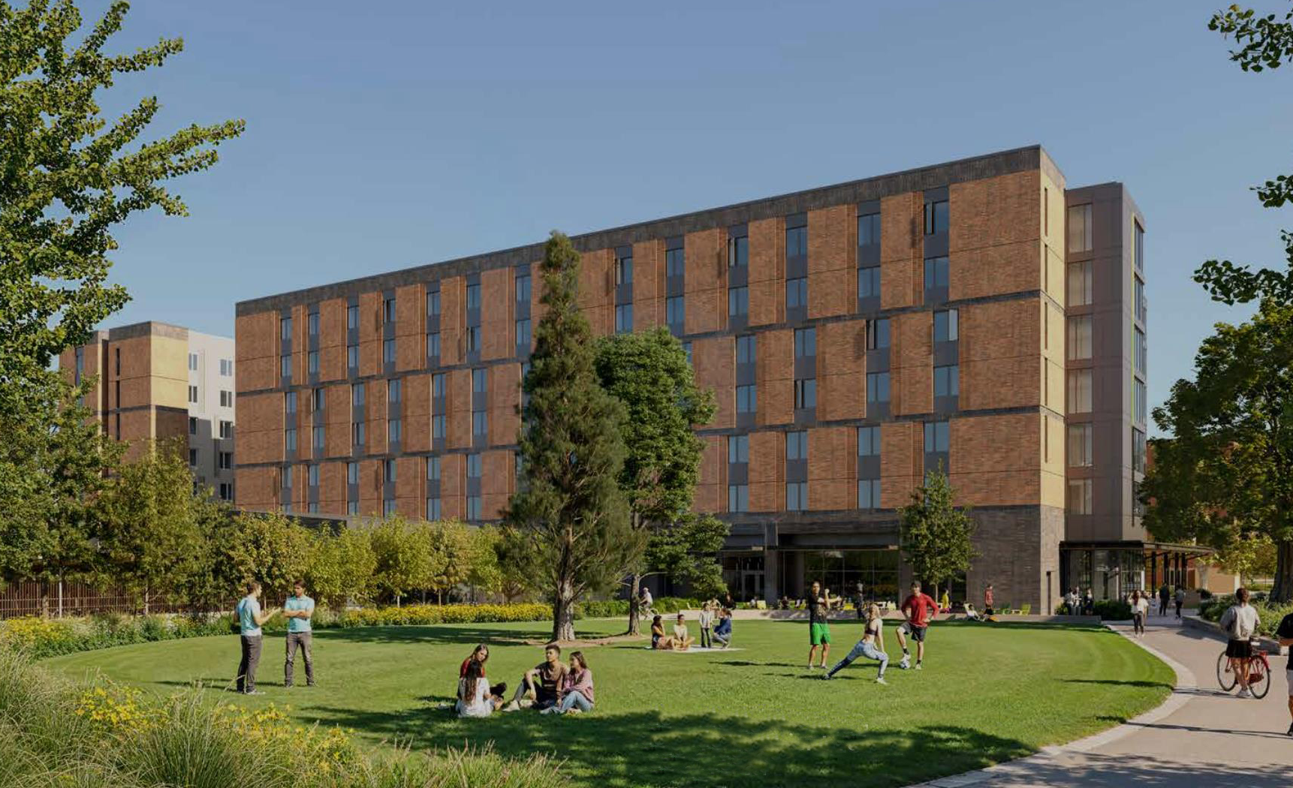
Next Generation Housing New Residence Hall – Building 1
Completion Fall 2027
Map

Slide 3
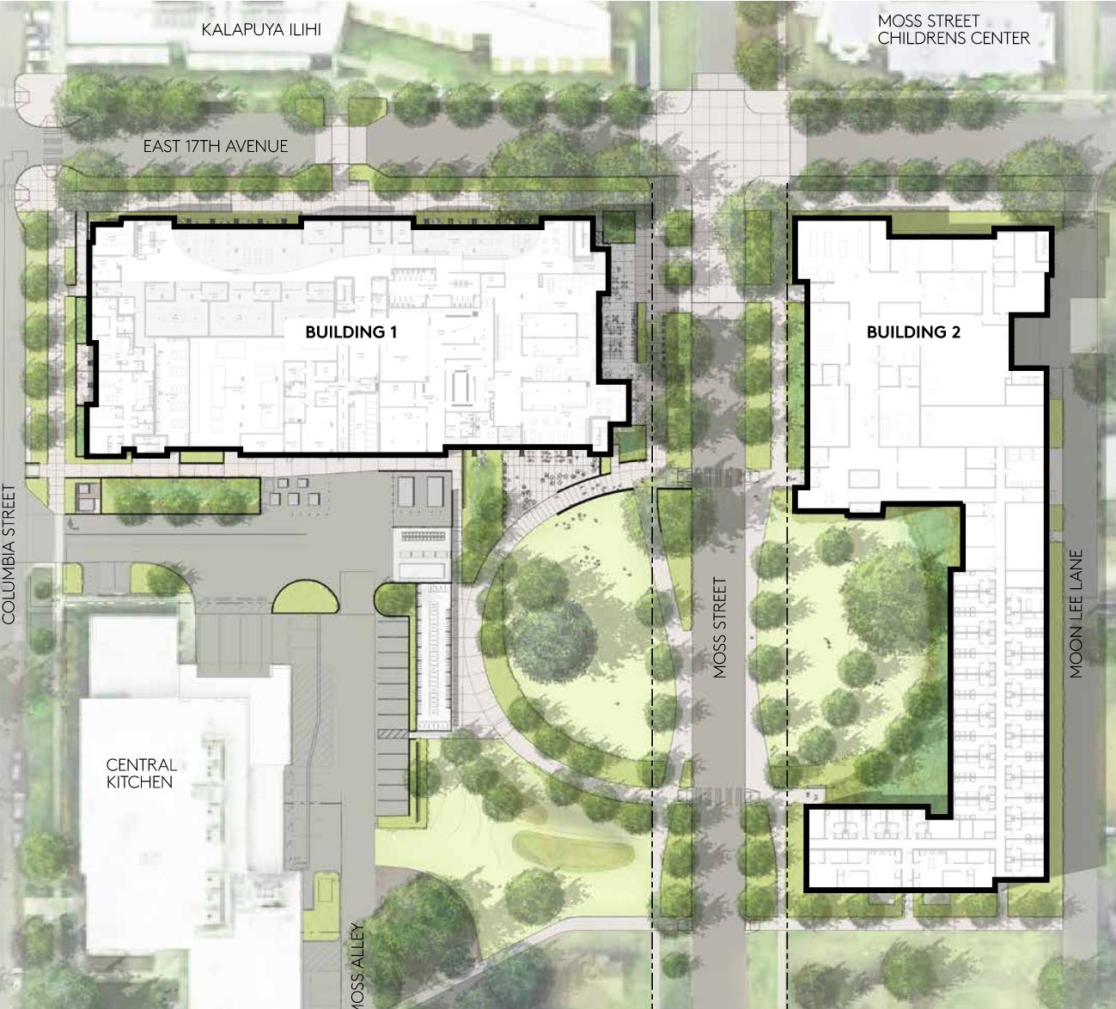
Next Generation Housing New Residence Hall – Phase 1 and 2
Building 1 – Completion fall 2027
Building 2 – Anticipate schematic design to begin 2025/2026
Map

Slide 4
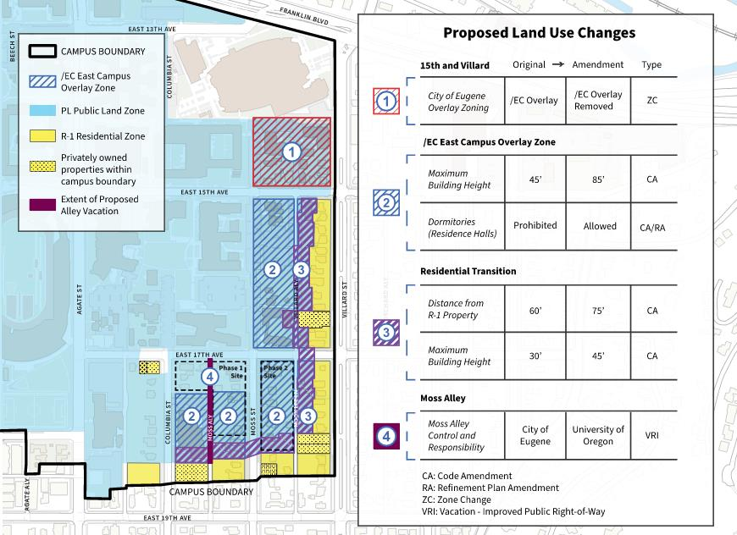
East Campus Land Use Updates
Planning Commission 10/21
City Council hearing Jan. 2026
Map

Slide 5
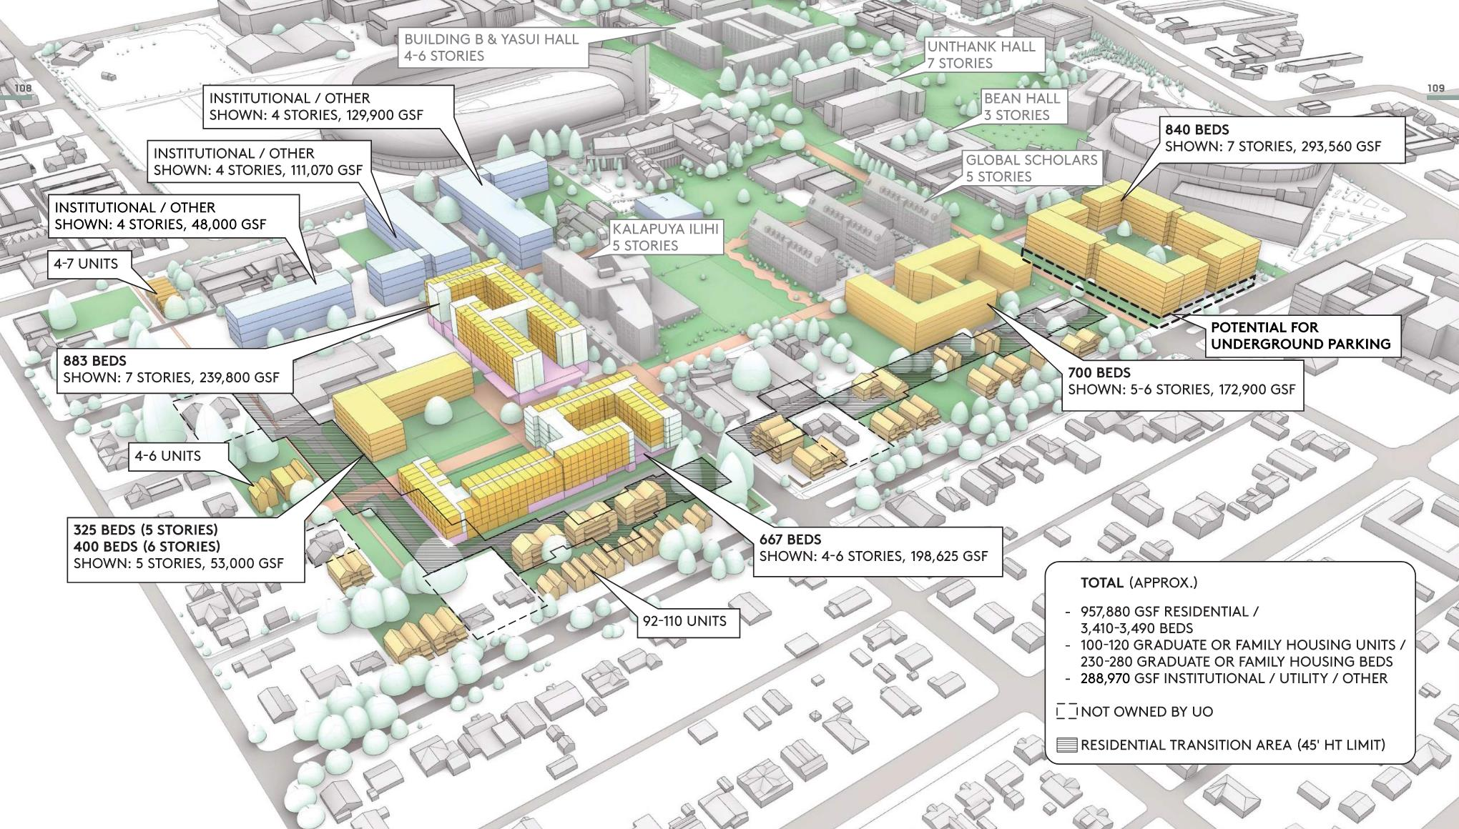
Next Generation Development Plan
Map

Slide 6
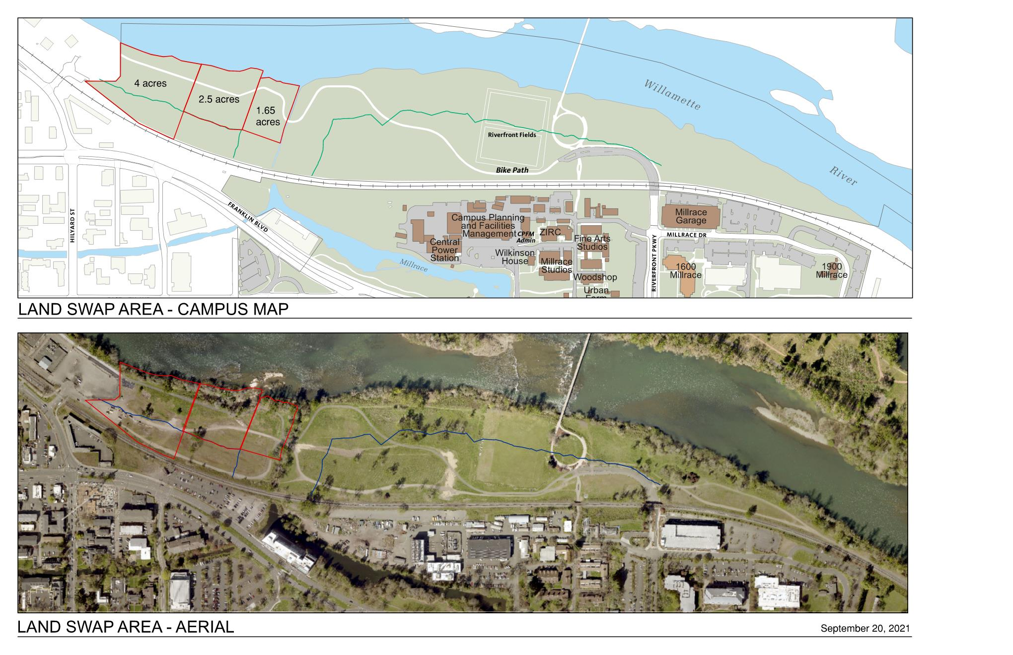
Land Swap with City of Eugene
8.1 acres of university property to city
Part of agreement with city for land at Autzen Stadium Complex
Completed September 2026

